Slide 1
🛍
ShopEase
E-Commerce Web Application
MCA Semester IV | AIT, Ahmedabad

Slide 2
What is ShopEase?
ShopEase is a full-stack, multi-role e-commerce platform built with Django (Python) and MySQL. It connects Customers, Sellers, and Admins in one seamless marketplace — with real product listings, cart management, order tracking, and discount codes.
👤 Customer
🏪 Seller
🛡️ Super Admin
Browse, search, add to cart, apply discounts, checkout
List products, manage inventory, track & update orders
Approve sellers, oversee platform, manage all data

Slide 3
Problem Statement
❌
❌
❌
Single-Role Systems
Login-Required Cart
No Seller Autonomy
No separation of Customer, Seller & Admin — security risk
Cart requires login — reduces conversion rates by 30%
All product management done by admin — creates bottlenecks
❌
❌
❌
No Discount System
Weak Security
Non-Responsive UI
No coupon engine — limits promotional campaigns for sellers
No CSRF, plain-text passwords, raw SQL injection vulnerabilities
Fixed layouts break on mobile — poor UX for majority of users

Slide 4
Key Features
🔐
🛒
🏪
Multi-Role Auth
Session Cart
Seller Dashboard
Customer / Seller / Admin login with session-based access control
Add products without login. Real-time total with GST & shipping
Add products, track orders, update status — full autonomy
🏷️
📦
🔒
Discount Engine
Order Management
Security Built-In
% or flat codes with expiry, usage limits, min order check
Sellers update: Pending → Shipped → Delivered
CSRF protection, SHA-256 hashing, Django ORM prevents SQL injection

Slide 5
Tech Stack
⚙️ BACKEND
🎨 FRONTEND
Python 3.13
Core programming language
Bootstrap 5
Responsive grid, components, utilities
Django 6.0.1
MVT framework — models, views, templates
Bootstrap Icons
Icon library across all pages
MySQL
Relational database (shopease_db)
HTML5 / CSS3
Template structure & custom styles
mysqlclient
Django-MySQL connectivity library
JavaScript ES6
Image preview, quantity controls, UX
Pillow
Image processing for product photos
Django Sessions
Cart data & user auth persistence
SHA-256
Secure password hashing
Django Templates
MVT pattern — dynamic HTML rendering

Slide 6
System Architecture
Browser
(User)
urls.py
(Router)
views.py
(Controller)
models.py
(ORM)
MySQL
DB
▶
▶
▶
▶
templates/
(HTML rendered)
Django Apps:
accounts/
products/
orders/
discounts/
URL Structure
/
Home Page
/products/
Shop All
/cart/
Cart
/seller/dashboard/
Seller Panel
/accounts/login/
Login
/seller/discounts/
Discount Codes

Slide 7
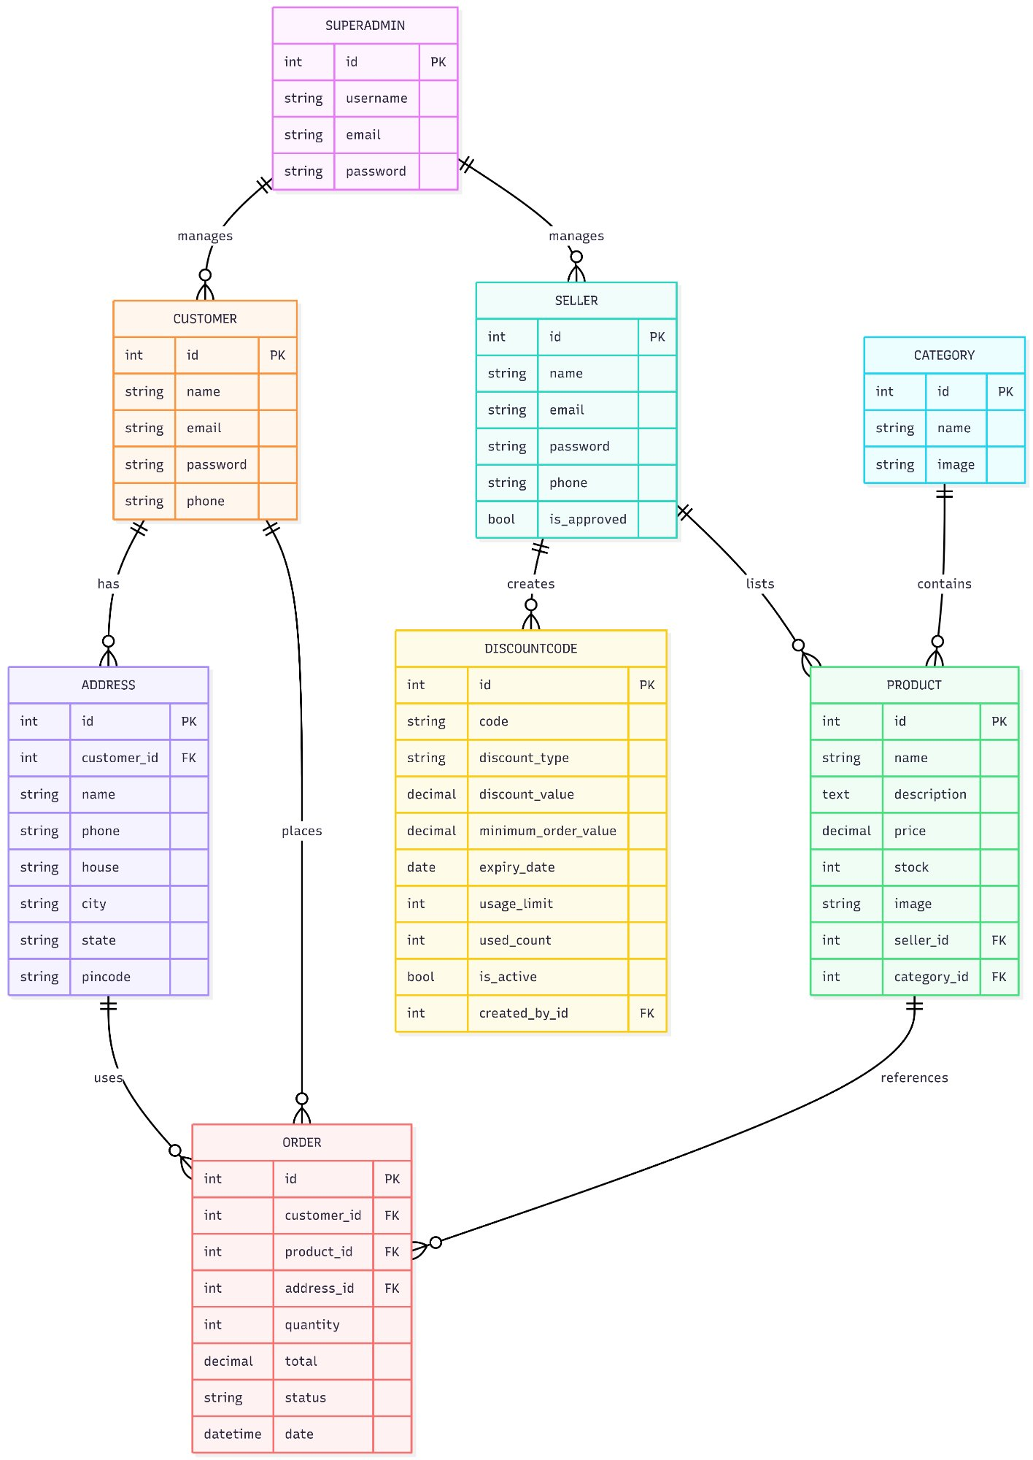
ER Diagram — 8 Entities with All Relationships

Slide 8
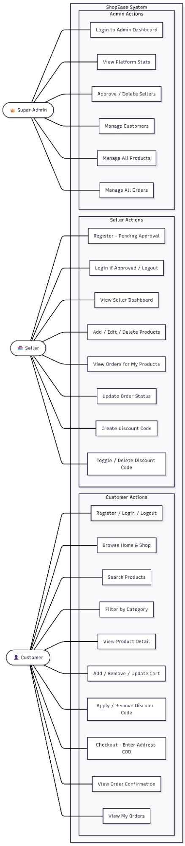
Use Case Diagram — Customer, Seller, Super Admin

Slide 9
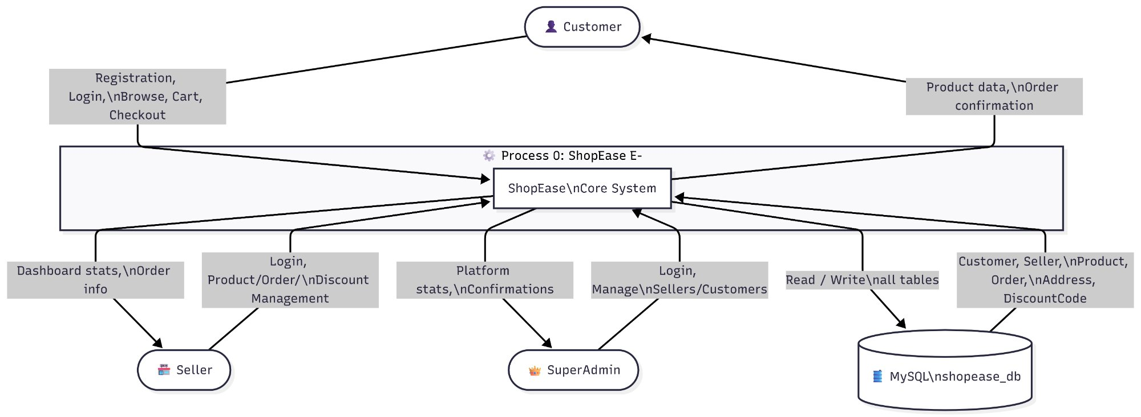
DFD Level 0 — Context Diagram

Slide 10
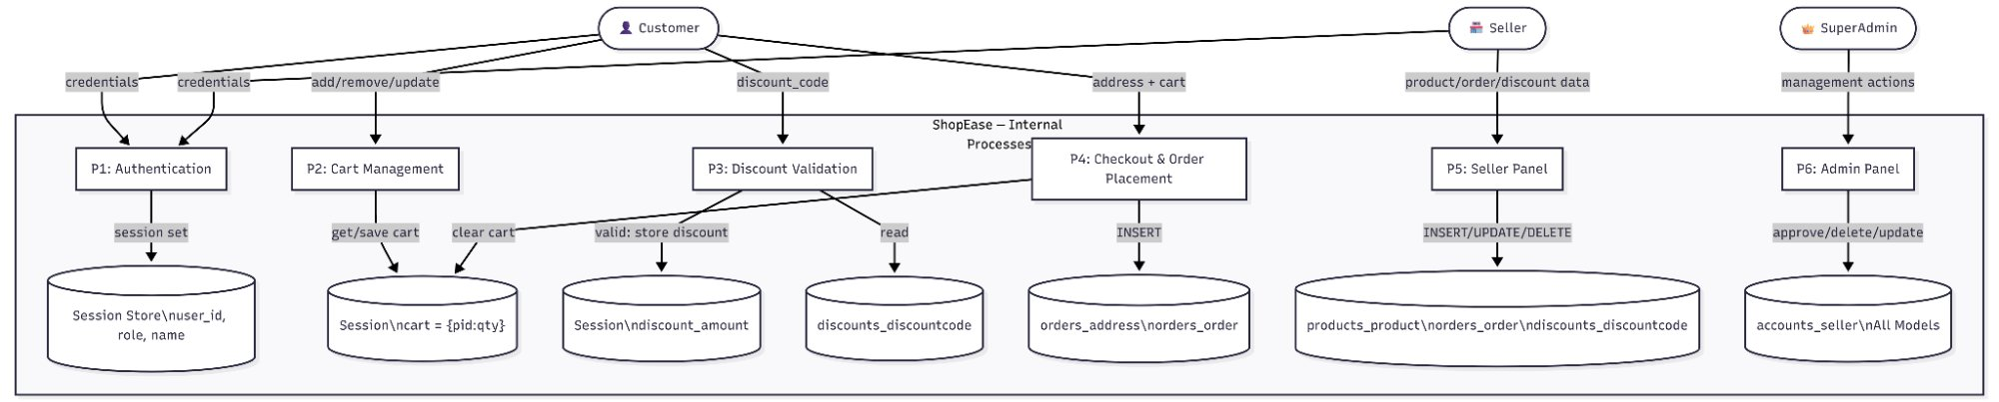
DFD Level 1 — Internal Processes

Slide 11
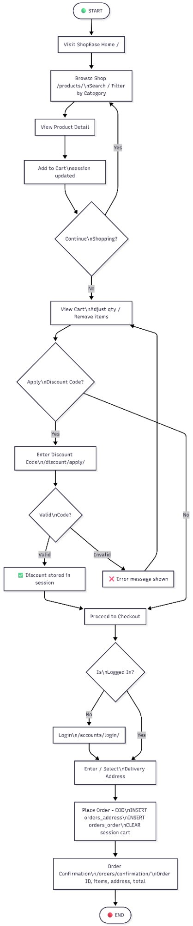
Activity Diagram — Customer Order Flow

Slide 12
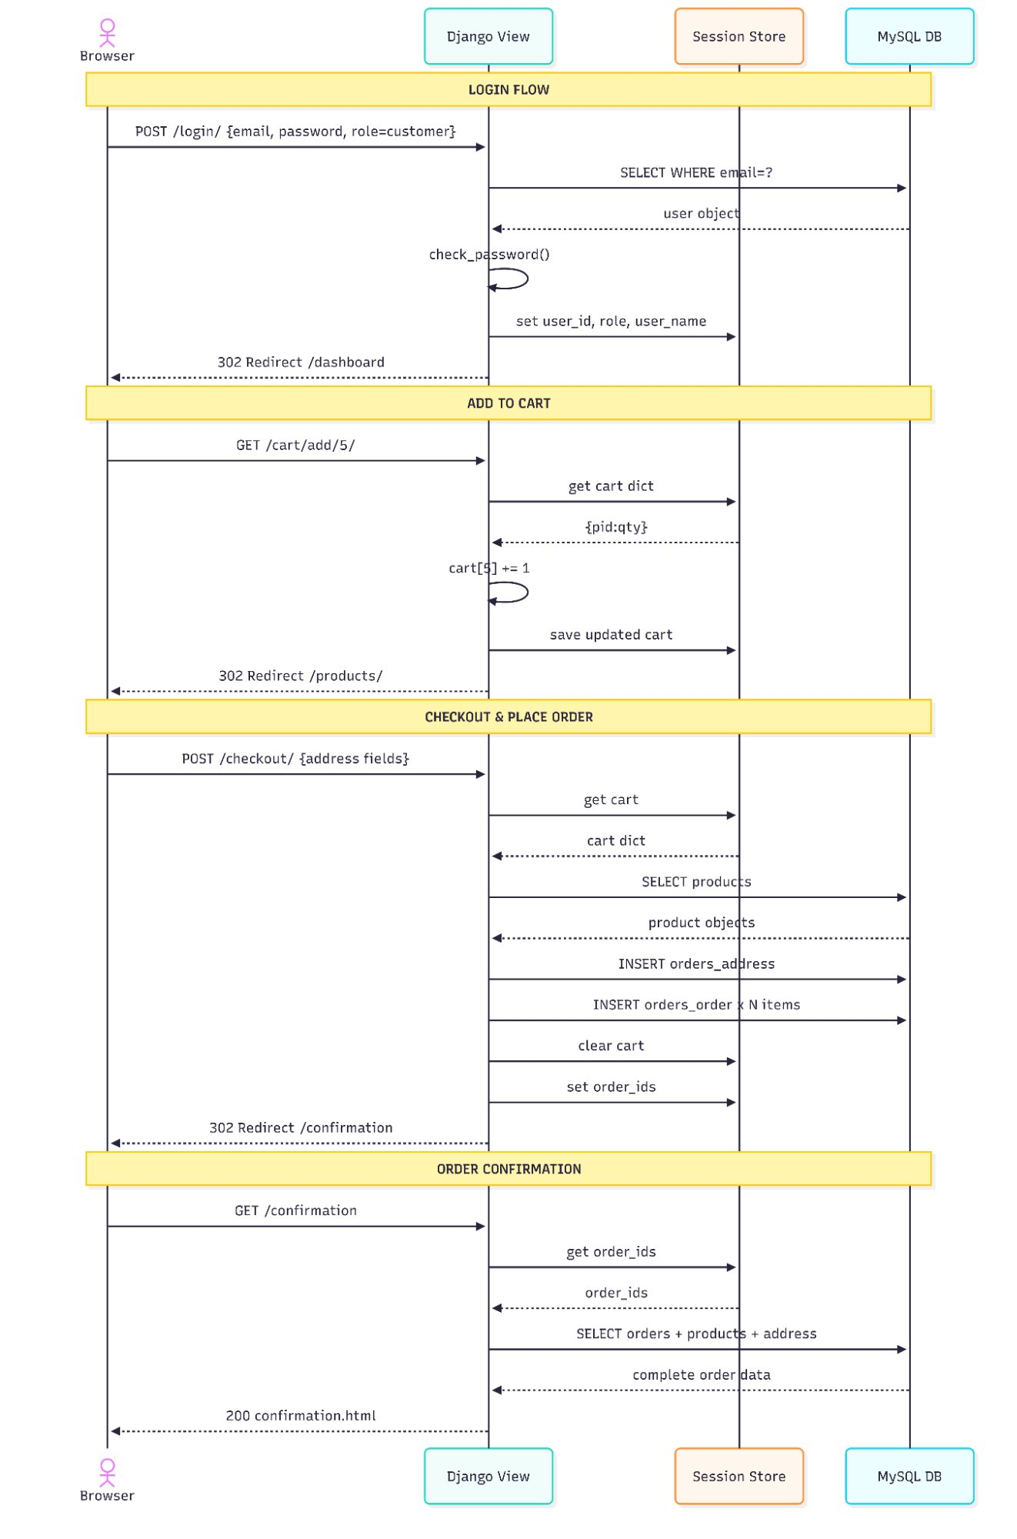
Sequence Diagram — Login, Cart & Checkout Flow

Slide 13
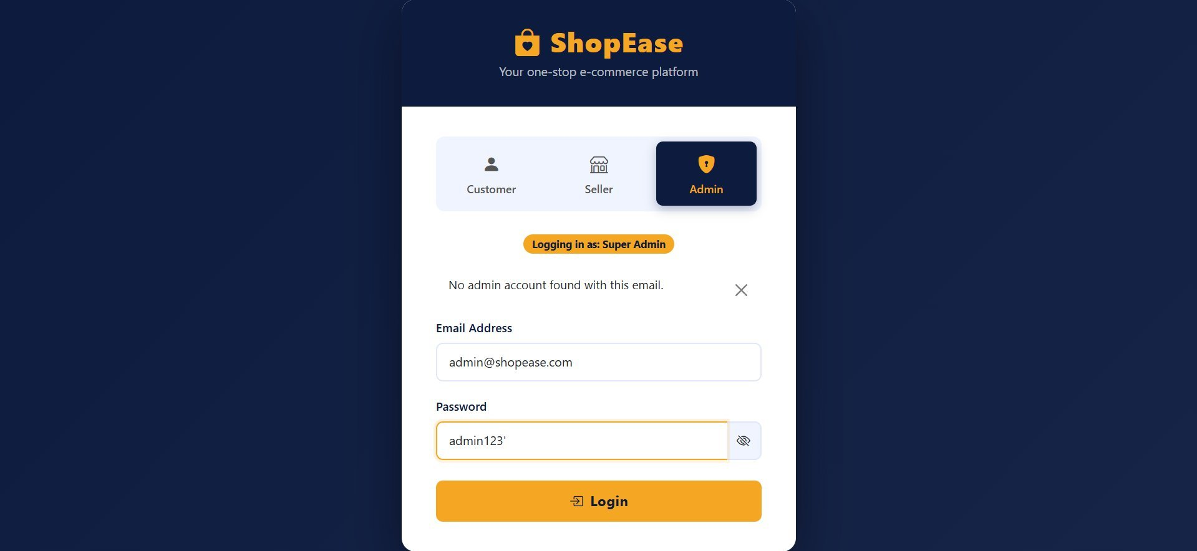
🔐 LOGIN PAGE
URL: /accounts/login/
👤
Role Selector
3 tabs: Customer, Seller, Admin
📧
Email Login
Email + Password authentication
🔒
SHA-256
Passwords hashed before DB storage
🎫
Session
Role stored in Django session on login
↩️
Redirect
Role-specific dashboard on success
🔑
Register
Link to register page for new users
Login Page — http://127.0.0.1:8000/accounts/login/

Slide 14
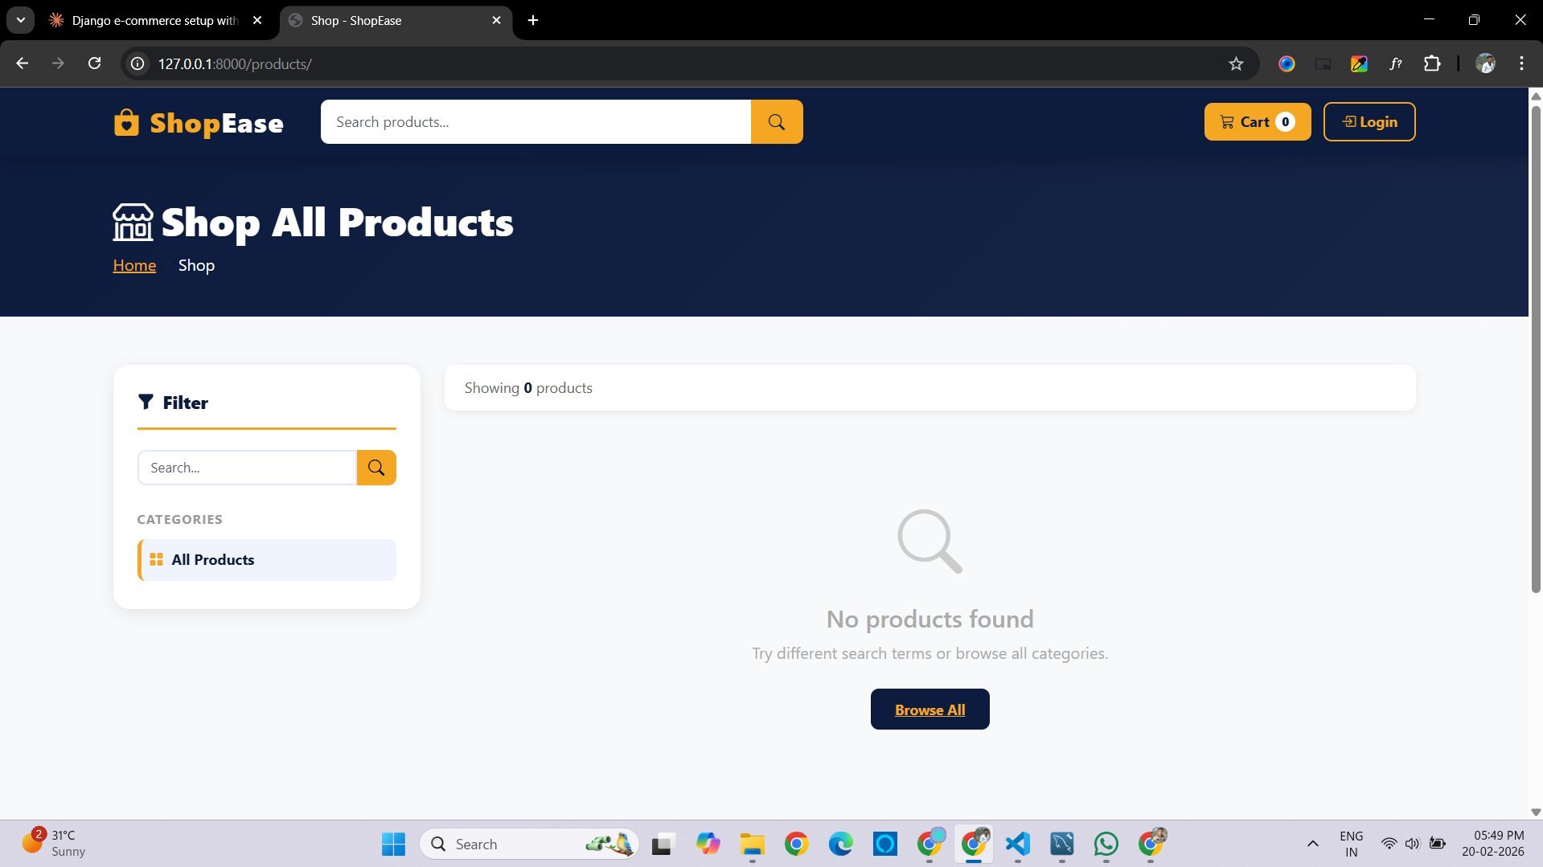
🛍 SHOP PAGE
URL: /products/
🔍
Search Filter
Search by product name in real-time
🗂️
Categories
Filter sidebar by product category
📦
Product Grid
Cards with image, name, price, Add to Cart
🔢
Item Count
Shows total matching products found
🛒
Add to Cart
Single click — adds to session cart
📱
Responsive
Mobile-friendly grid layout
Shop Page — http://127.0.0.1:8000/products/

Slide 15
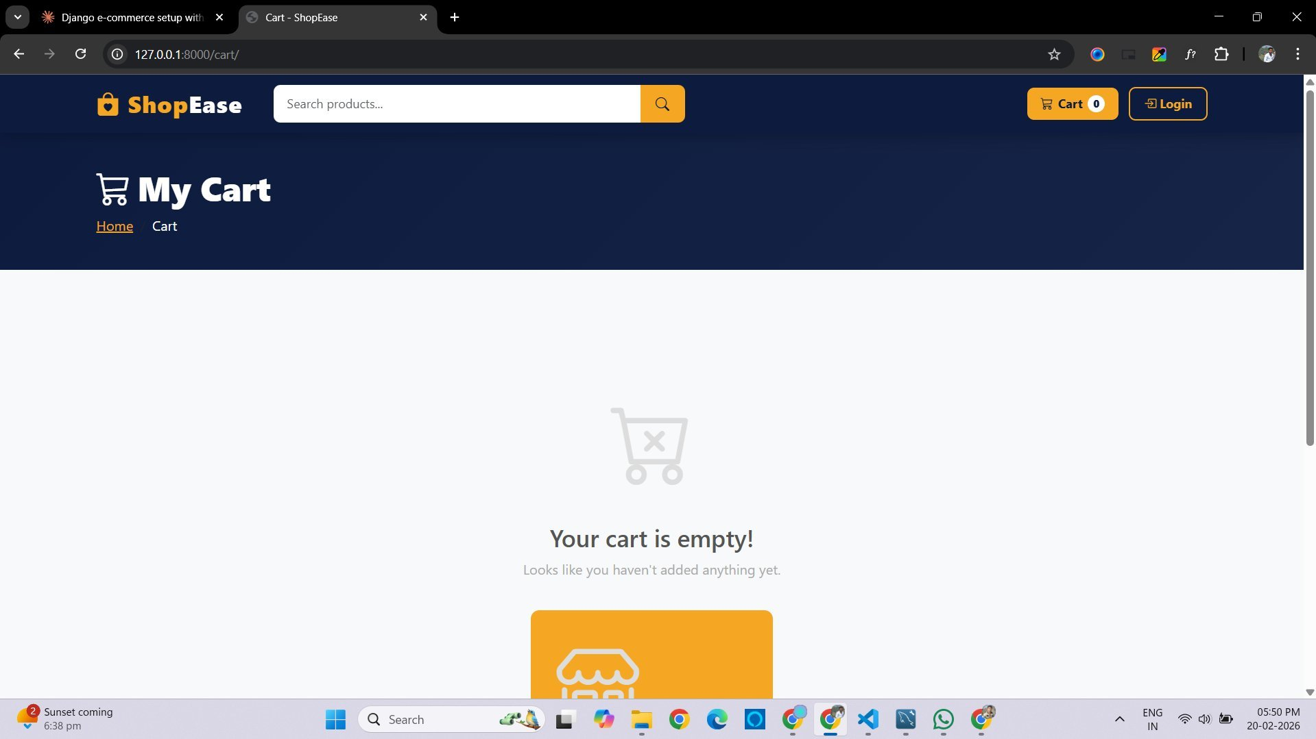
🛒 CART PAGE
URL: /cart/
📋
Cart Items
Product image, name, price, quantity
➕➖
Qty Control
Increase / Decrease / Remove buttons
🏷️
Discount Code
Enter coupon → instant price update
💰
Price Breakup
Subtotal + GST 5% + Shipping logic
🚚
Free Shipping
Free above ₹499, else ₹49
✅
Checkout
Proceed to Checkout button
Cart Page — http://127.0.0.1:8000/cart/

Slide 16
🏪 Seller Panel
Seller Panel
12
34
₹8,450
📊 Dashboard
Total Products
Total Orders
Total Earnings
📦 My Products
Recent Orders
➕ Add Product
#1
Product A
₹450
Pending
🛍 My Orders
#2
Product B
₹320
Shipped
#3
Product C
₹900
Delivered
🏷️ Discounts
Seller Panel URLs:
🏠 Visit Store
• /seller/dashboard/
• /seller/products/
🚪 Logout
• /seller/product/add/
• /seller/product/edit/1/
• /seller/orders/
• /seller/discounts/

Slide 17
Database Design
Customer
accounts/
Seller
accounts/
Product
products/
🔑 Customer_id (PK)
🔑 Seller_id (PK)
🔑 Product_id (PK)
▸ name
▸ name
▸ name
🔗 category_id (FK)
▸ email (unique)
▸ email
▸ price
▸ password (SHA256)
▸ password
▸ stock
▸ phone
▸ is_approved
▸ image
🔗 seller_id (FK)
Category
products/
Order
orders/
DiscountCode
discounts/
🔑 Category_id (PK)
🔑 Order_id (PK)
🔑 Discount_id (PK)
▸ name
🔗 customer_id (FK)
▸ code (unique)
▸ image
🔗 product_id (FK)
▸ discount_type
▸ quantity
▸ discount_value
▸ date
▸ total
▸ expiry_date
▸ status
▸ usage_limit

Slide 18
🏷️ Discount Code System
HOW IT WORKS
DiscountCode Model Fields
Seller Creates
code
Unique coupon string (e.g. SAVE10)
1
Sets code name, type (% or flat), value, min order, expiry, usage limit
discount_type
percentage or flat
discount_value
Amount: 10 (%) or 50 (₹)
2
Customer Applies
Enters code on Cart page → system validates all conditions
minimum_order_value
Min cart total required
expiry_date
Auto-invalidates after date
3
Validation
usage_limit
Max number of uses allowed
Checks: Active? Not expired? Under usage limit? Cart total ≥ minimum?
used_count
Times already used (auto++)
4
Applied
is_active
Toggle on/off by seller
Discount amount stored in session → grand total recalculated instantly

Slide 19
🔒 Security Features
CSRF Protection
SHA-256 Hashing
🛡️
🔐
All forms use {% csrf_token %} — blocks cross-site request forgery attacks
Passwords hashed with SHA-256 before storage — never stored in plain text
SQL Injection Safe
Session Security
💉
🎫
Django ORM uses parameterized queries — SQL injection is inherently blocked
Server-side sessions with role-based access checks on every protected view
Input Validation
Role-Based Access
✅
🔑
Forms validate required fields, file types, and data formats server-side
Sellers can't access admin routes. Customers can't access seller panel

Slide 20
Future Enhancements
🔐
💳
🤖
Face Recognition Login
Payment Gateway
AI Chatbot
OpenCV + dlib face recognition for customer login (Phase III)
Razorpay integration — UPI, cards, wallets replacing COD
NLP-powered customer support for product recommendations
🔔
📧
☁️
Real-Time Notifications
Email Verification
Cloud Deployment
WebSocket push notifications for order status updates
OTP-based email verification and password reset
AWS/GCP deployment with domain, SSL certificate & scaling

Slide 21
🛍
Thank You!
ShopEase — Your One-Stop E-Commerce Platform

